Slide 1
Unit 8 Lecture : 15 and 16
Market Analysis :
Market, Different types of Market,
Perfect Competition:
Characteristics of Perfect Competition,
Short run Equilibrium of Perfect Competition or
price output determination of perfect competition.

Slide 2
OBJECTIVES
At the end of this unit, you should be able to:
explain how perfectly competitive market behave
discuss what determines the firm’s profit?
state assumptions of perfect competitive market
explain short equilibrium of a firm in perfect competition market.

Slide 3
A market is a place where parties can gather to facilitate the exchange of goods and services. The parties involved are usually buyers and sellers. The market may be physical, like a retail outlet, where people meet face-to-face, or virtual, like an online market, where there is no physical presence or contact between buyers and sellers.

Slide 4
Key Takeaways of Market
A market is where buyers and sellers can meet to facilitate the exchange or transaction of goods and services.
Markets can be physical, like a retail outlet, or virtual, like an e-retailer.
Markets establish the prices of goods and services, determined by supply and demand.

Slide 5
Market
Normally two types of market are available of an economy, i.e., perfect competition and imperfect competition. Imperfect competition are classified as; monopoly, monopolistic competition, oligopoly, duopoly etc.

Slide 6
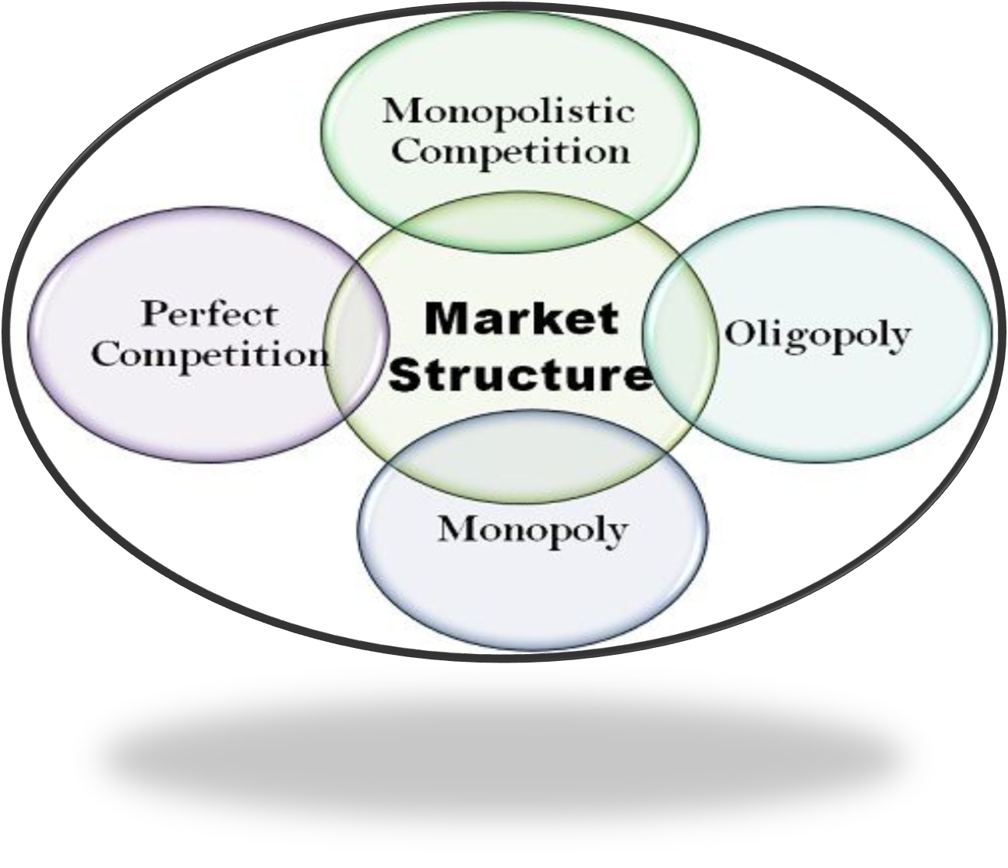
Market Structure

Slide 7
Market Structure
Perfect competition – Many firms, freedom of entry, homogeneous product, normal profit.
Monopoly – One firm dominates the market, barriers to entry, possibly supernormal profit.
Oligopoly – An industry dominated by a few firms, e.g. 5 firm concentration ratio of > 50%. Interdependence of firms.

Slide 8
Market Structure
Monopolistic competition – Freedom of entry and exit, but firms have differentiated products. Likelihood of normal profits in the long term.
Duopoly – where two firms dominate the market. For example, Pepsi and Coca Cola. Android vs Apple. A duopoly falls between a monopoly and oligopoly.

Slide 9
Market Structure
Market Structure | Monopolistic Competition | Oligopoly | Monopoly
Market Size | A large number of firms | A small number of dominant firms | Single dominant firm
Barriers to Entry | Relatively lower barriers to entry | High barriers to entry | Extremely high barriers to entry
Product Differentiation | Slightly differentiated products | May have differentiated or undifferentiated products | Unique product

Slide 10
Perfect Competition :
A market is said to be perfect when all the potential sellers and buyers are promptly aware of the prices at which transactions take place and all the offers made by other sellers and buyers, and when any buyer can purchase from any seller and conversely. Under such a condition, the price of a commodity will tend to be the same all over the market.

Slide 11
Characteristics
The perfect competition is based on the following characteristics :
Large number of buyers and sellers;
Homogeneous product;
Perfect knowledge about prices;
Freedom of entry and exit from the industry;
The goal of firms is profit maximization;
No government regulation;
Perfect mobility of factors of production;
Absence of transport costs.

Slide 12
Short-run equilibrium of perfect competition
Short-run has been defined as a period of time sufficient to allow the firm to adjust its output by increasing or decreasing the amount of variable factors of production, but during which fixed factors of production cannot be altered. Thus in the short-run the size and kind of plant cannot be changed, nor can new firms enter the industry.

Slide 13
conditions of perfect competitive firm
There are two conditions of firm’s short-run equilibrium under the perfect competition:
Marginal Cost (MC) = Marginal Revenue (MR) = Price (p)
MC curve must cut MR curve from below; i.e., the slope of MC> the slope of MR

Slide 14
Assumptions
In explaining the equilibrium of a firm under perfect competition in the short-run, we assume that all firms are working under identical cost conditions, i.e., average cost and marginal cost curve are identical. We also assume that the factors of production used by the different firms are homogeneous and are available at given and constant prices.

Slide 15
Analysis
The twin conditions of equilibrium ensure that profits have been maximized or losses minimized, but they do not tell about the firm’s loss or shut down position . In this connection there are four possibilities:
When the firm makes super normal profits;
When it makes only normal profits;
When it incurs losses, but still does not shut-down; and
Shut-down position.

Slide 16
The firm makes super normal profits
The following figure illustrate the super normal profits in the short-run of perfect competitive firm. In the following figure, the average and marginal cost curves of the firm together with its demand curve. We said that demand curve is also the average revenue curve and the marginal revenue curve of the firm in a perfectly competitive market.

Slide 17
The marginal cost curve cuts the short-run average total cost (SATC) at its minimum point. So, the firm is in equilibrium at the level of output defined by the intersection of the MC and MR. At point e, the MC curve intersect the MR curve and the firm’s output is 0X. The second condition for equilibrium requires that the MC be rising at the point of its intersection with the MR curve.

Slide 18
This means that the MC must cut the MR curve from below, i.e., the slope of the MC must be steeper than the slope of the MR curve. Thus, at point e, both conditions for equilibrium are satisfied. So, at point e, the per unit cost is BX, per unit revenue or price is eX or OP, per unit profit equal to per unit revenue minus per unit cost, i.e., per unit profit = (eX – BX ) = eB total profit equal to per unit profit multiply by total output, i.e., total profit = eB * OX = eB * AB,

Slide 19
which is the area of ABeP, and it is also the super normal profit of perfect competition.
SMC
Revenue,
Cost, Price SATC
P
MR = P=AR
A B
0 X OUTPUT
e

Slide 20
When it makes only normal profits
Thus, at point e, both conditions for equilibrium are satisfied. So, at point e, the per unit cost is eX, per unit revenue or price is eX or OP, per unit profit equal to per unit revenue minus per unit cost, i.e., per unit profit = (eX – eX ) = 0, total profit equal to per unit profit multiply by total output, i.e., total profit = 0 * OX = 0, which is the normal profit of perfect competition.

Slide 21
Revenue, Cost, Price
SMC
SATC
e
P MR = P
0 X Output

Slide 22
What is Normal Profit?
Normal profit is an economic term that refers to a situation where the total revenues of a company are equal to the total costs in a perfectly competitive market. It means that the company makes sufficient revenues to cover the overall cost of production and remain competitive in its respective industry. When a company reports a normal profit, it means that its economic profit is equal to zero, which is the minimum amount that justifies why the business is still in operation.

Slide 23
losses, but not shut-down
Thus, at point e, both conditions for equilibrium are satisfied. So, at point e, the per unit cost is BX, per unit revenue or price is eX or OP, per unit loss equal to per unit cost minus per unit revenue, i.e., per unit loss = (BX - eX ) = eB, total loss equal to per unit loss multiply by total output, i.e., total loss = eB * OX = eB * AB, which is the area of ABeP, and it is also the total loss of perfect competition.

Slide 24
Revenue, Cost, Price
SMC SATC
A B
e
P MR = P
0 X Output

Slide 25
Shut-down position
The firm will continue to produce only if it covers its variable costs, other wise it will shut down, since by discontinuing its operations the firm is better off, it minimizes its losses the point at which the firm covers its variable costs is called the closing down point. In the following figure SAVC means the short – run average variable cost.

Slide 26
At point e is the closing down point and price is OP or X, if the price is falls below the OP or eX, the firm does not cover its variable cost and is better off if it closes down. The firm will continue if and only if
P = SAVC, otherwise shut – down.

Slide 27
Revenue, Cost, Price
SMC SATC
SAVC
A B
e
P MR = P
0 X Output

Slide 28
Shut-down position
At point e is the closing down point and price is OP or eX, if the price is falls below the OP or eX, the firm does not cover its variable cost and is better off if it closes down. The firm will continue if and only if P = SAVC, otherwise shut – down.

Slide 29
EXERCISE
What do you understand by perfect competition market? Discuss the basic assumptions underlying this market.
Show with the aid of a graph the short run equilibrium of a firm in perfect competition market.
At what point do you think a firm should shut down?

